Slide 1
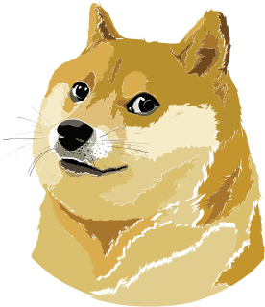
The Art Of Memes A Visual Language Of The Internet
ENG 101

Slide 2
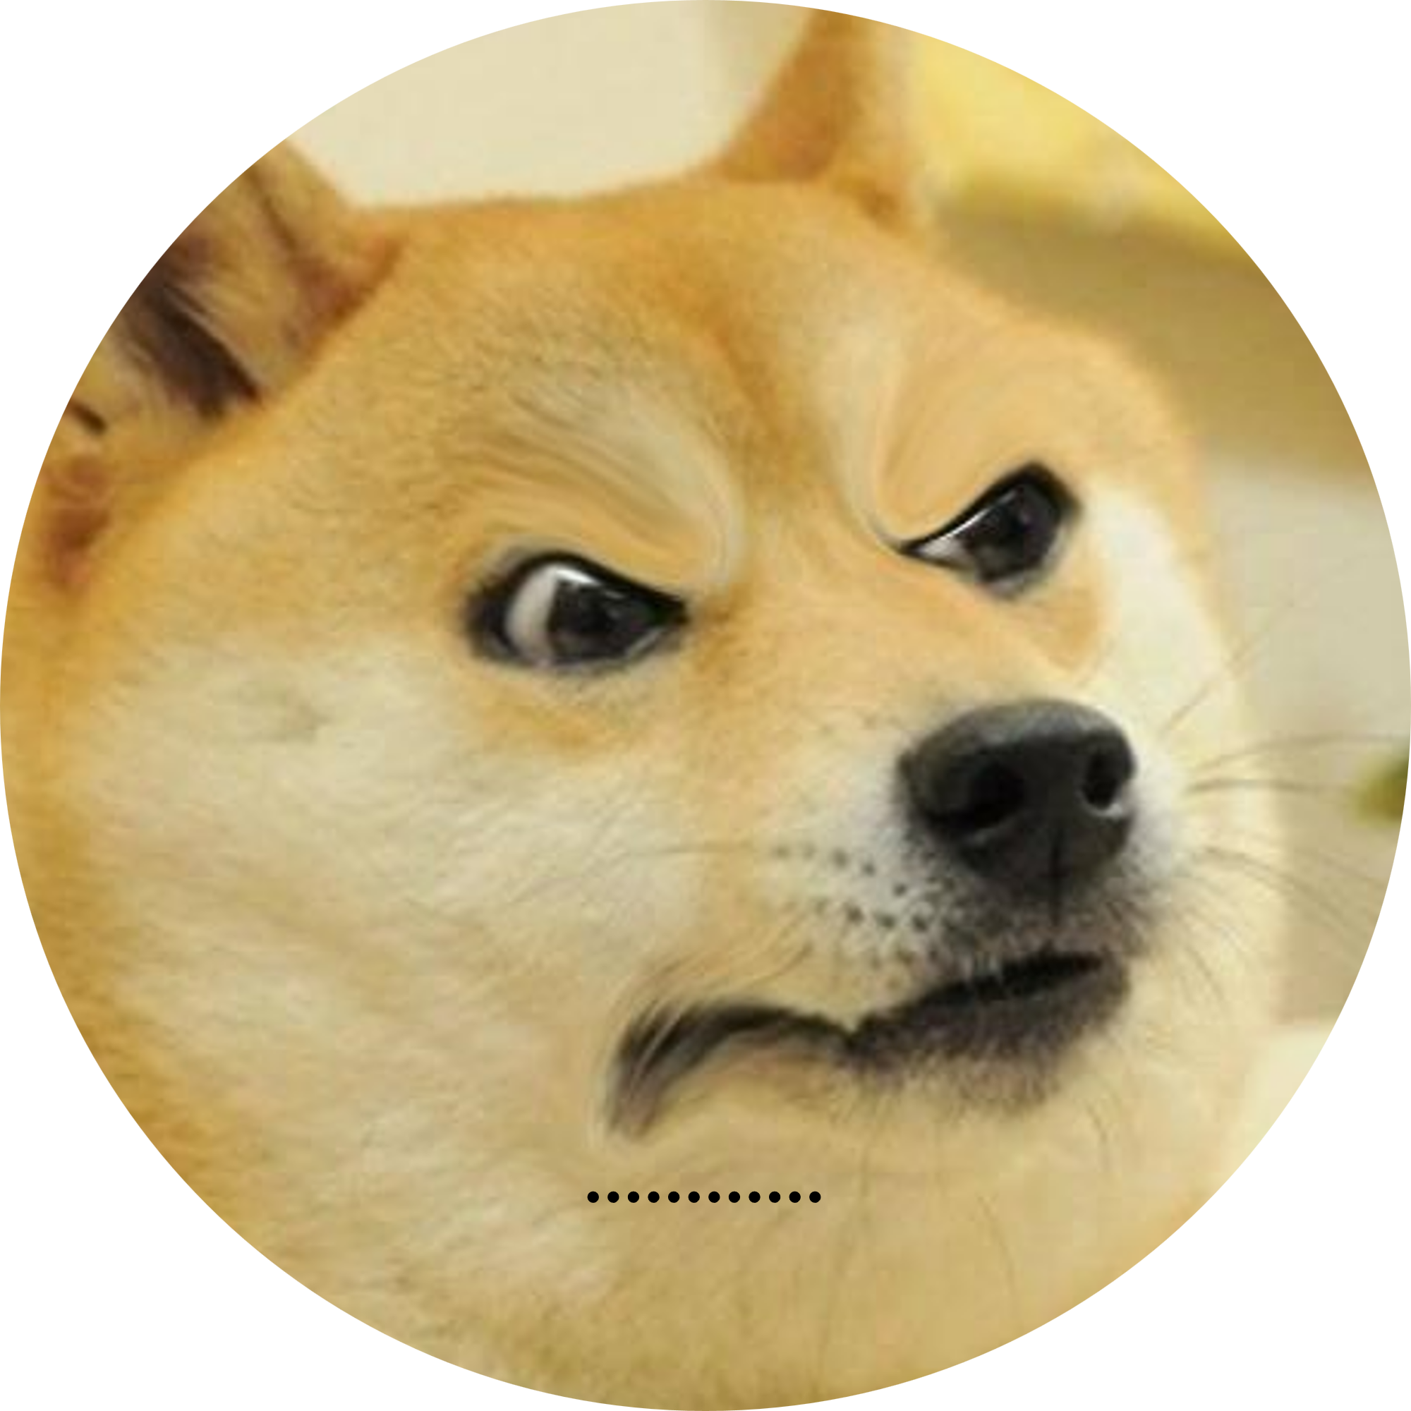
Introduction
FARJAN AHMMED
ID : 0242320005341738

Slide 3
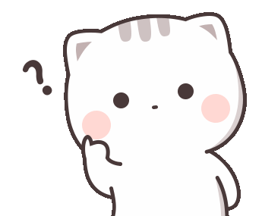
What Is Meme
A meme is a piece of media, usually an image, gif or video that is copied and modified by many people online.
Memes are often humorous, sarcastic, or ironic, and they reflect the culture and opinions of the internet users who create and share them.

Slide 4
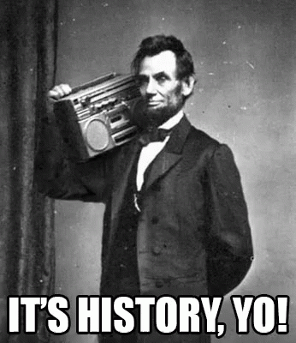
History
Originating in the '90s, internet memes evolved from text-based jokes to iconic gifs like the "Dancing Baby." The 2010s saw memes go mainstream on platforms like Reddit, with formats like "Advice Animals" and "Pepe the Frog." In the 2020s, memes continued to adapt, influencing politics and short-form video on platforms like TikTok, showcasing their dynamic role in internet culture.

Slide 5
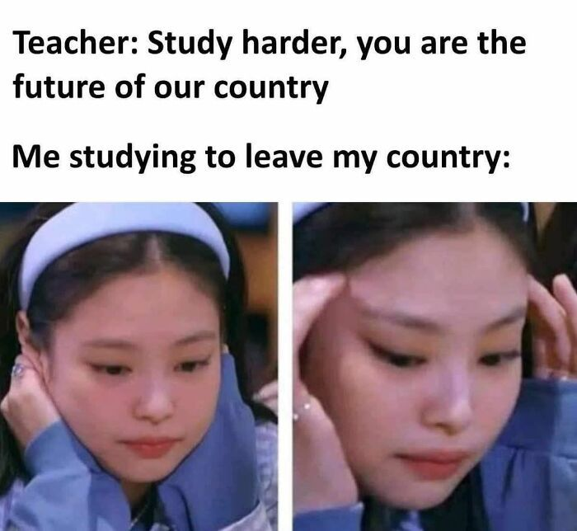
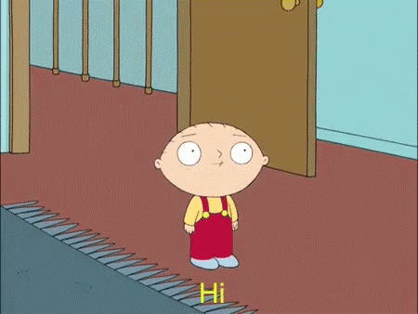

Common Meme Formats
Image Macros: Static images with text, allowing for easy replication and modification.
GIFs: Animated images capturing a specific emotion or reaction, often repurposed for various contexts.
Video: A video meme is a short, humor-infused video clip circulating on the internet, often following a recognizable format for relatable and comedic communication.

Slide 6

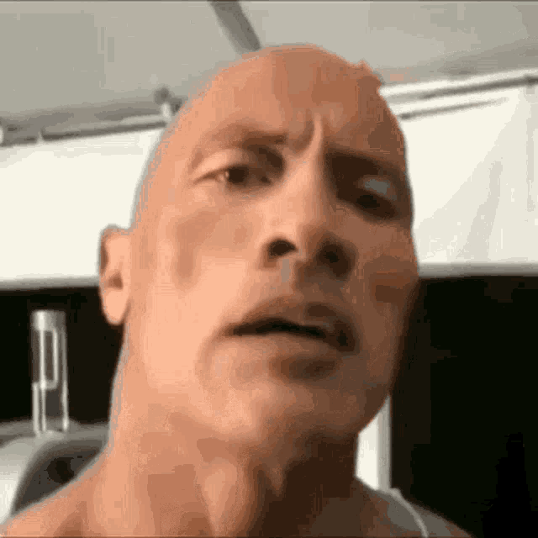
Artistic Side of Memes
Memes act as mirrors reflecting societal trends, humor, and shared experiences, offering a snapshot of contemporary culture.
Memes provide a succinct and creative means of expressing complex ideas, emotions, and reactions in the digital age.
Shared humor creates a sense of community, fostering a connection among individuals who identify with specific memes or subcultures.
Memes spread rapidly across the internet, transcending geographic and linguistic boundaries, creating a global network of shared humor.

Slide 7
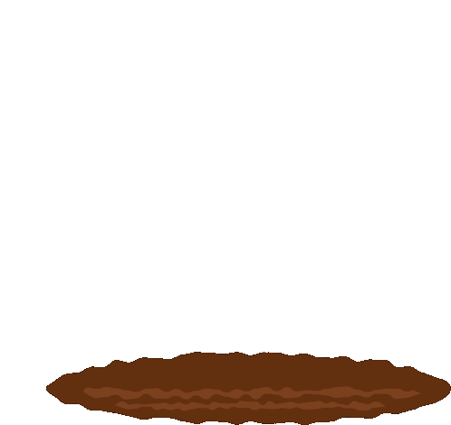
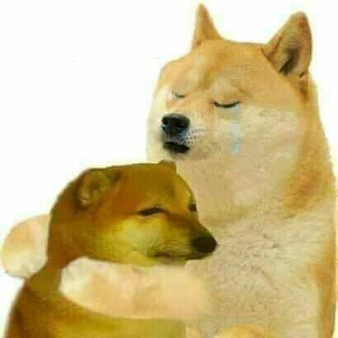
Dark Side Of Memes
Memes can perpetuate false information or misleading narratives, contributing to the spread of misinformation in a humorous guise.
Some memes rely on stereotypes or insensitive content, reinforcing negative biases and potentially causing harm or offense.
Meme culture can be weaponized for cyberbullying, as individuals may create and share memes to mock or harass others online.
Dark memes can normalize harmful ideologies, desensitizing individuals to serious issues and contributing to a toxic online culture.

Slide 8
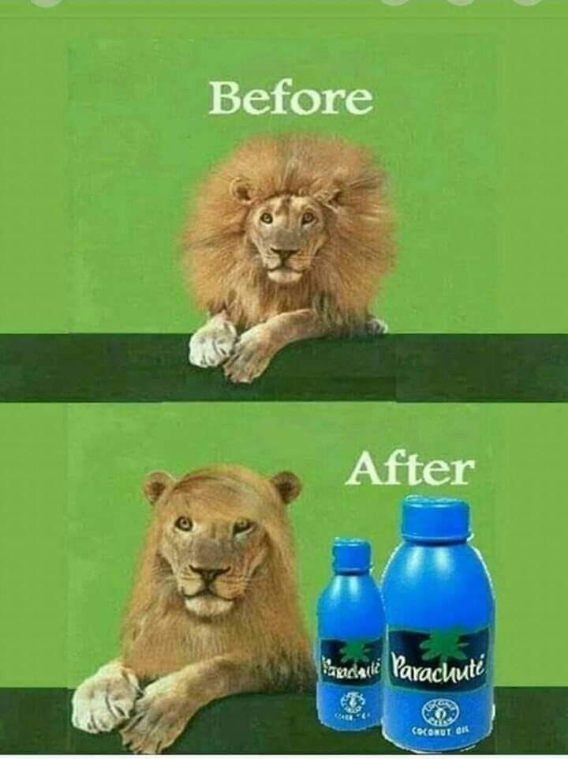
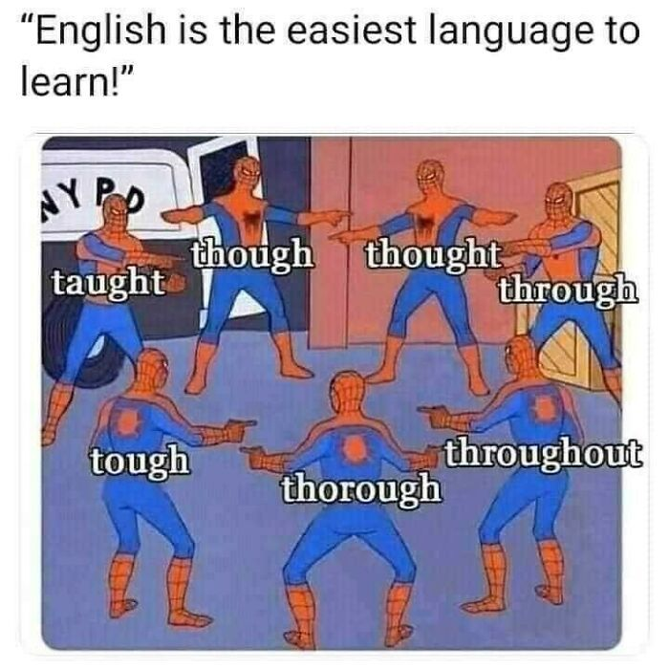
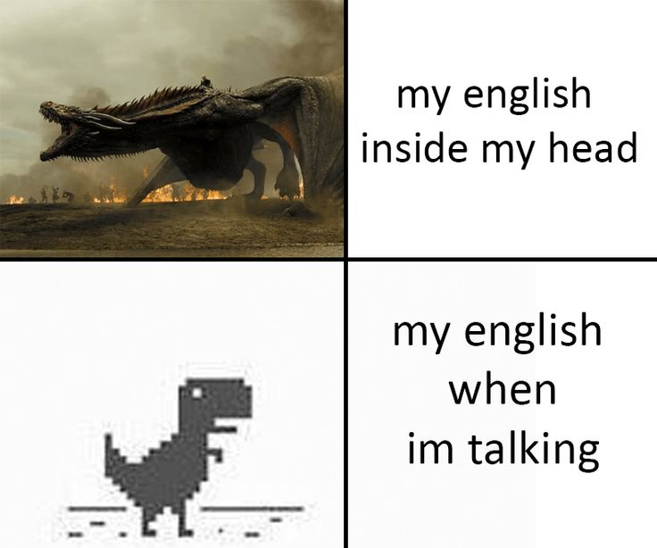
Some Meme Examples

Slide 9
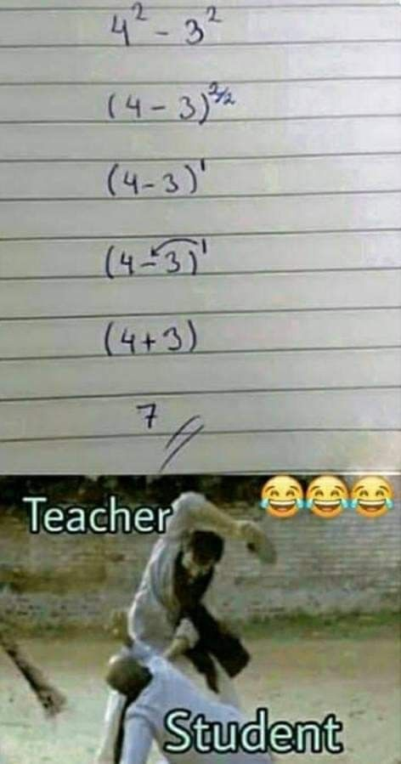
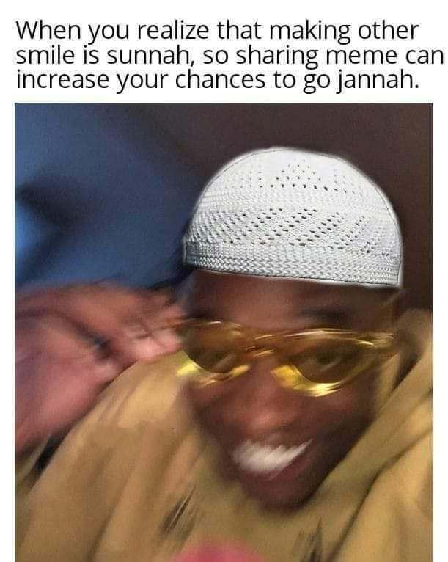
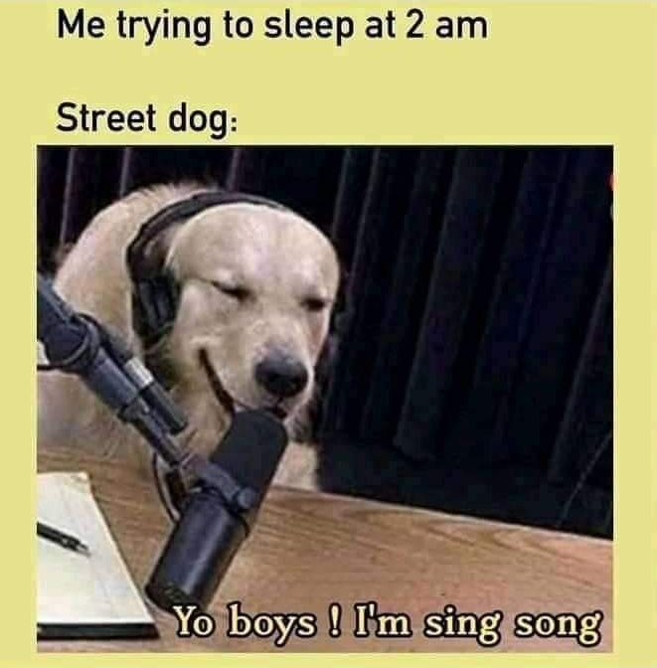

Slide 10
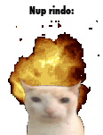
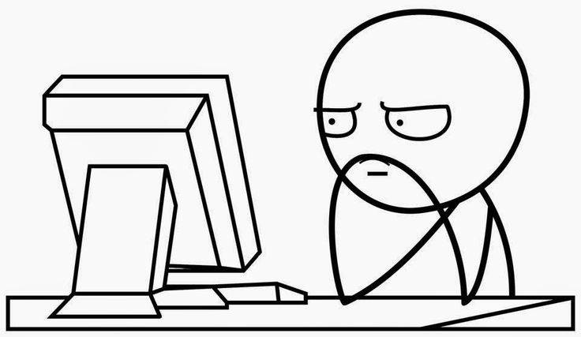
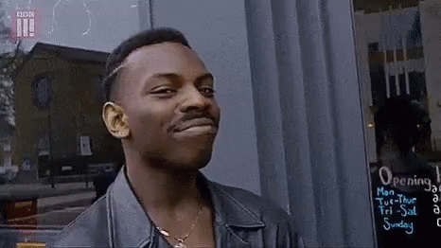
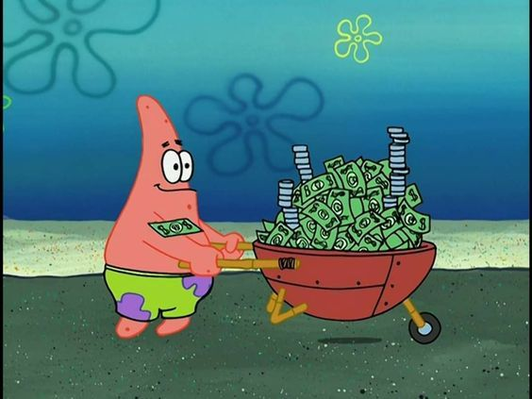
Future Of Memes
Memes are likely to continue evolving as a prominent form of online communication, influencing how people express thoughts and emotions in a concise and relatable manner.
The future may see increased involvement of artificial intelligence in meme creation, with algorithms generating memes based on current trends and user preferences.
We may witness the development of meme economies where individuals, influencers, and brands actively participate in meme creation and dissemination for promotional purposes.

Slide 11
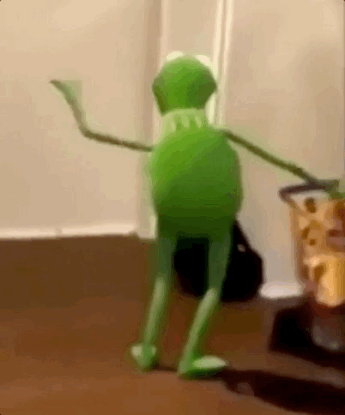

Q & A

Slide 12

